Slide 1
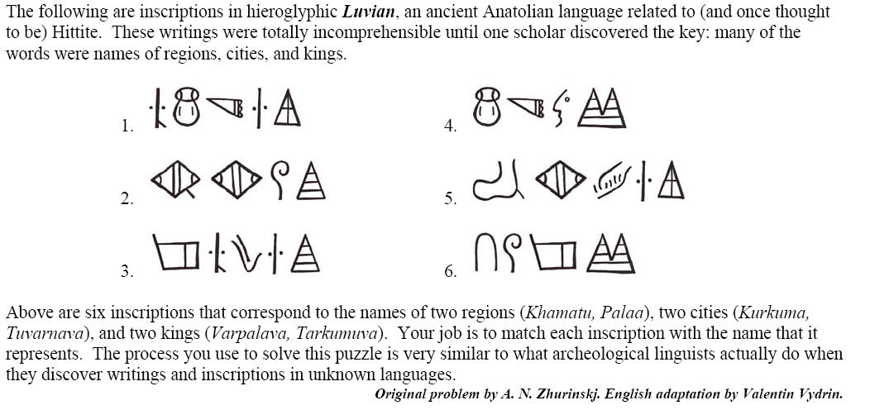
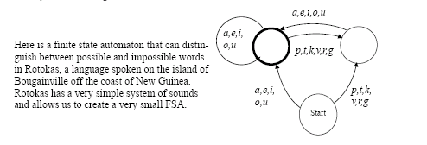
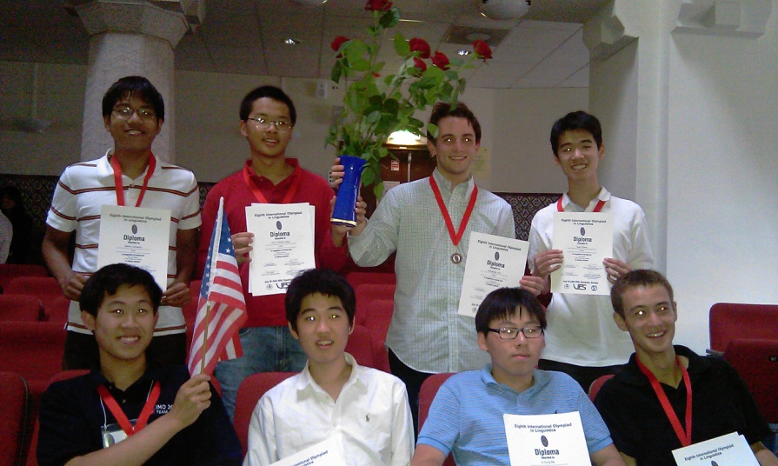
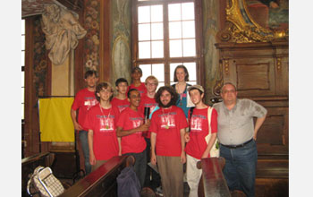
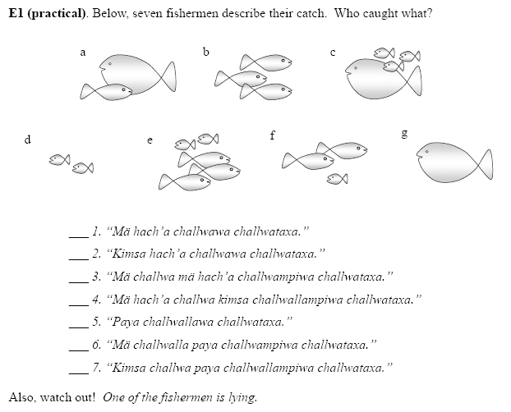
Web: http://www.naclo.cs.cmu.edu
Email: naclo13org@umich.edu
n
a
c
l
o
North American Computational Linguistics Olympiad
What is NACLO?
A contest in which high school students learn about linguistics and language technologies by solving puzzles
How do students benefit?
NACLO helps students identify potential careers related to languages and language technologies and helps them learn about subjects they may want to study in college. They also exercise problem solving skills and have fun.
What is linguistics?
Linguists study human language in general – what kinds of sounds do they have? What kinds of syllables? What kinds of grammar? How do children learn languages? Why is it so much harder for adults to learn languages? Why are there dialects?
What is computational linguistics?
Computational linguistics is the science behind language technologies. You use language technologies when you speak to an automated telephone system, or to your car or phone; when you ask a computer to translate something for you; and every time you do a search in a Web browser.
Timeline
Registration is now open:
http://www.naclo.cs.cmu.edu
NACLO is free and open to all students under 20 years old who do not yet have a high school diploma.
Open Round: January 31, 2013
About 1500 students will compete in the US and Canada.
In the Pittsburgh area, you can compete at your school or at Carnegie Mellon University.
Invitational Round: March, 2013
100 students will be selected to compete.
Training: April – June, 2013
20 students will be selected for Skype-based training sessions.
International Linguistics Olympiad: July, 2013, Manchester, UK
8 students will represent the US.
Who sponsors NACLO?
Language Technologies Institute
School of Computer Science
Gelfand Center for Community Outreach
Department of English
Wugs used with permission.
© Jean Berko Gleason
http://www.ioling.org

